Slide 1

Costco Gas Station
Simulation Analysis & Modeling
Daniel Clepper

Slide 2
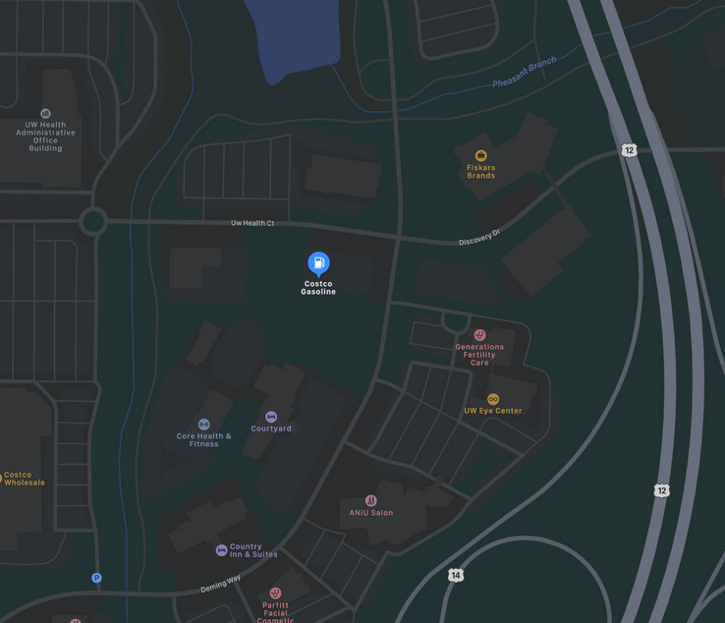
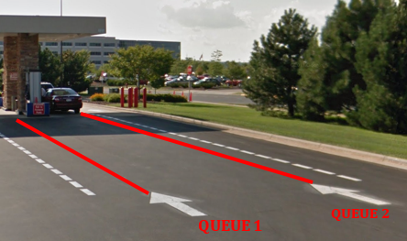
Introduction
My Objectives
to build an Arena model that accurately represents the Costco gas station system
to propose and compare potential system improvements, and
to provide a final recommendation on the best feasible alternative system.
Notes:
For this project, I analyzed the behavior of cars pumping gas at the Costco gas station on the west side of Madison, Wi.
The gas station has a total of 12 total pumps, where 6 queues feed into each set of two pumps.
I tracked the behavior for queues 1 and 2.
Objectives of this project:
to build an Arena model that accurately represents the Costco gas station system
to propose and compare potential system improvements, and
to provide a final recommendation on the best feasible alternative system.

Slide 3
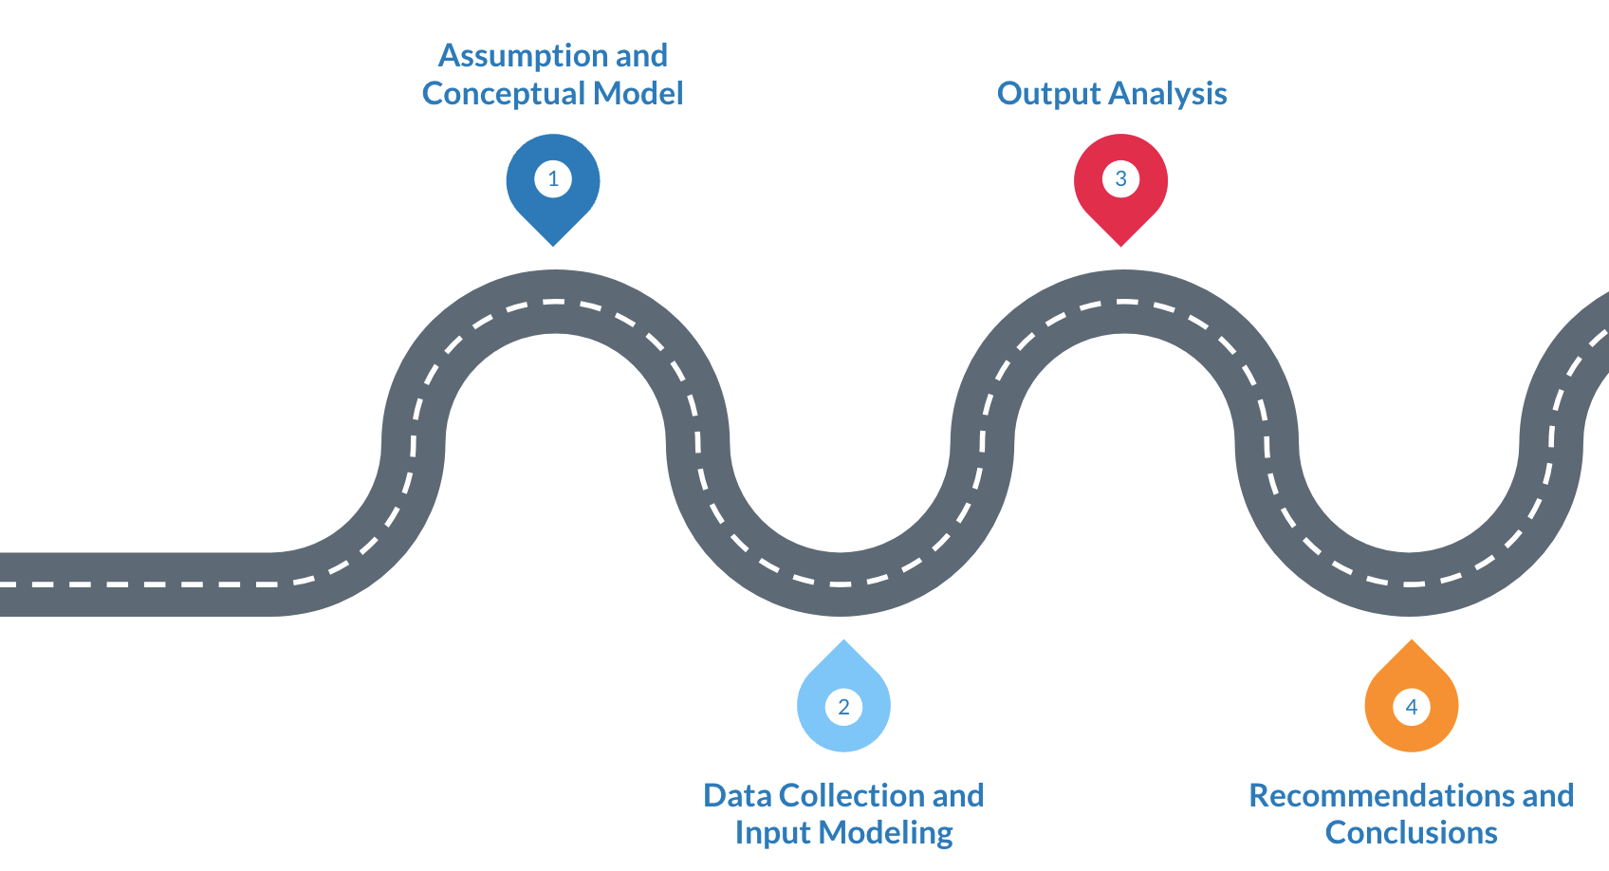
Roadmap

Slide 4
1.
Assumptions and Conceptual Model

Slide 5
Key Simulation Details & Structural Assumptions
Entities:
Temporary: arriving vehicles & drivers
Permanent: 4 gas pumps
Attributes: FIFO queuing discipline
Key events: vehicle arrivals, pump starts, and vehicle departures
Activities: interarrival times & service times
Variables: fuel tank size, desired level of refueling, & driver familiarity/speed of using the pump

Slide 6
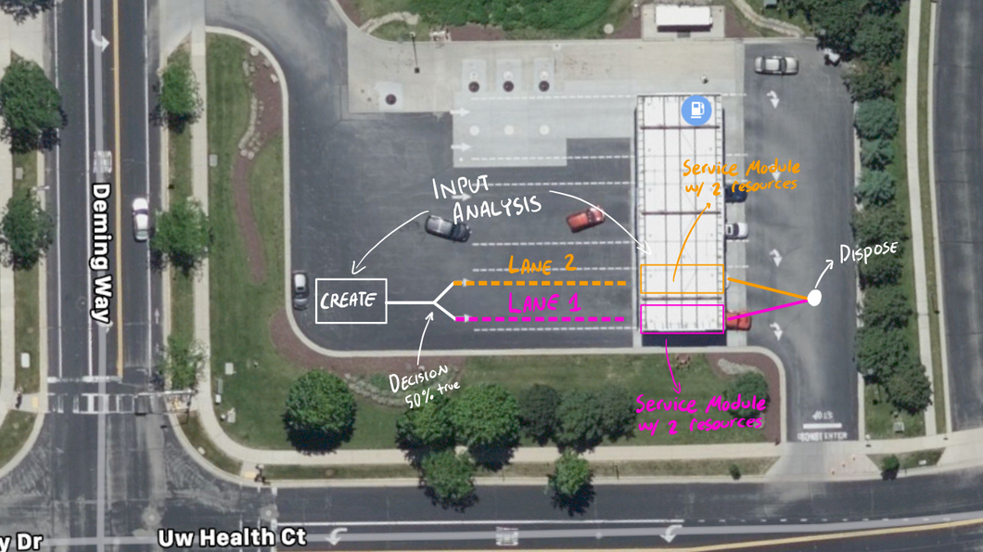
Model Drawing

Slide 7
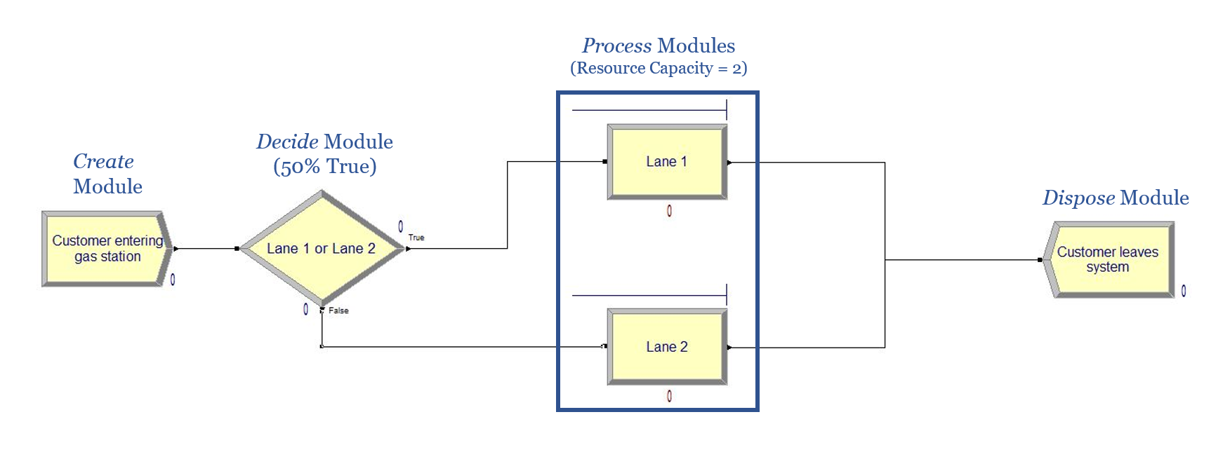
Building the Arena Model
Let’s take a look at the model in Arena!

Slide 8
Model Verification & Data Assumptions
Verify with Vanessa Sawkmie
Arena process analyzer
Tracing 16 customers
More details on next slides

Slide 9
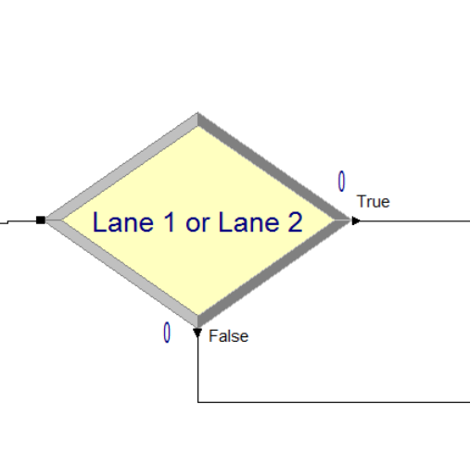

Verification with Vanessa Sawkmie
Preliminary verification of model
Ignore balking/jockeying/reneging due to low probability
Set decide module to 50% true (more on this in validation section)

Slide 10
Arena Process Analyzer
 | Controls |  | Responses
Scenario | Rate | Speed | System Num. Out | Lane 1 Queue Time (sec) | Lane 2 Queue Time (sec) | Lane 1 pump utilization | Lane 2 pump utilization
1 | 1 | 1 | 36.5 | 739.8 | 959.2 | 95.7% | 95.9%
2 | 2 | 1 | 26.6 | 61.7 | 93.7 | 67.0% | 74.7%
3 | 1 | 0.5 | 57.5 | 31.8 | 55.9 | 70.3% | 76.2%
4 | 2 | 0.5 | 29.0 | 0.0 | 0.00 | 34.9% | 39.3%

Slide 11

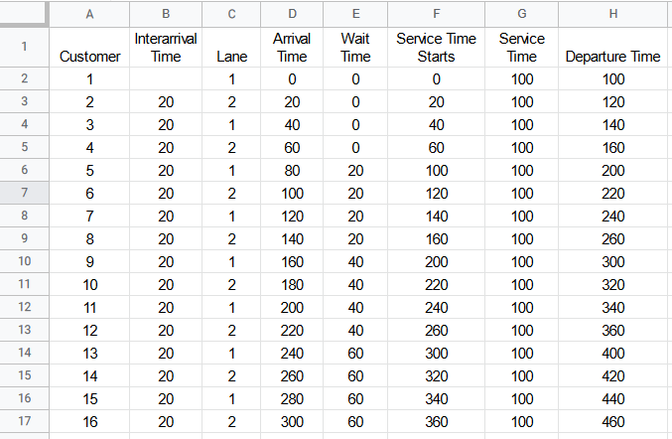
Tracing 16 Customers through System
 | Manual Simulation | Arena Model Simulation
Avg. Customer Total Time | 130 sec | 130 sec
Avg. Customers Wait Time | 30 sec | 30 sec
Lane 1 Avg. Wait Time | 30 sec | 30 sec
Lane 2 Avg. Wait Time | 30 sec | 30 sec
Lane 1 Pump Utilization | 86.96% | 86.96%
Lane 2 Pump Utilization | 86.96% | 86.96%
System Number Out | 16 | 16

Slide 12
2.
Data Collection and Input Modeling

Slide 13
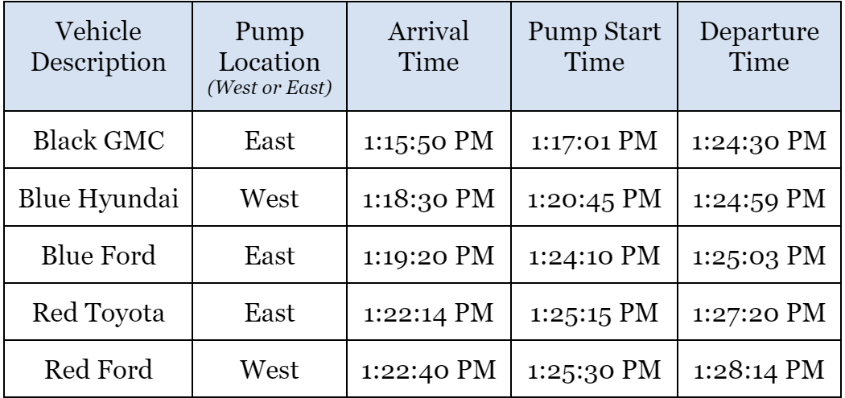
Data Collection
Notes:
Data were collected on 4/2/2022 and 4/9/2022.
On both days, the students arrived at Costco around 1 pm and collected an hour’s worth of data.
The arrival time, pump start time, and the departure time for each vehicle for each lane were recorded on separate spreadsheets.

Slide 14

Data Processing
The data was processed to determine the interarrival and service times.
Notes:
Data was processed to determine the interarrival times and service times.
Arrival, pump start, and departure times were all combined in one spreadsheet (sorted by date and then time.
Interarrival and Service times were calculated and converted into seconds.

Slide 15
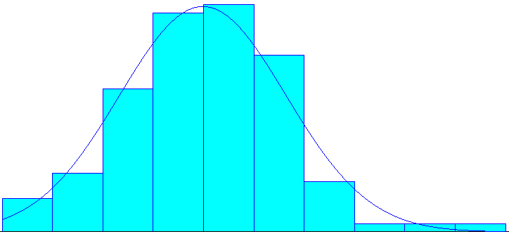
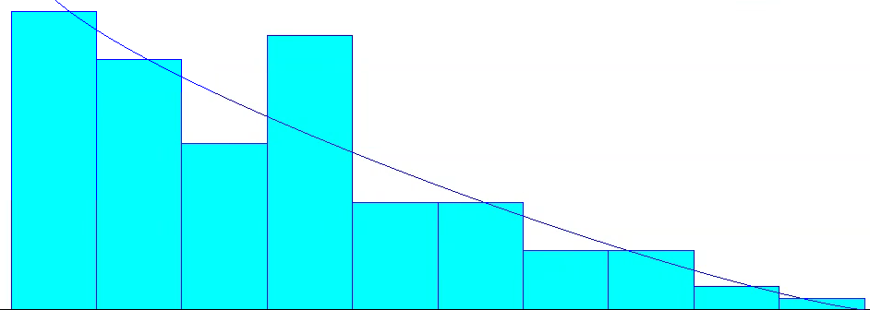
Input Analysis
Interarrival Time
Service Time
Norm(211,65.44)
-0.001 + 180*BETA(0.943,2.22)

Slide 16
Model Validation
Face validity
Collected Data vs. Arena Simulation Data
T-Tests
More details on next slides

Slide 17
Face Validity and Model Comparison
Face validity
Average data approximation found decide module to be 50% true (validated original assumption)
Approximated distributions (covered in previous slide)
Compared collected summary data to Arena simulation data (see photo to right)
 | From Data Collection | From Arena Model Simulation | Percent Difference
Customer Output over 63.35 minutes | 58.5 | 61.5 | 5.13%
Avg. Service Time | 208.9 | 209.2 | 0.16%
Avg. Wait Time | 202.2 | 212.5 | 5.10%
Avg. Time in System | 395.3 | 421.7 | 6.69%
Avg. Lane 1 Pump Utilization | 79.1% | 86.2% | 9.06%
Avg. Lane 2 Pump Utilization | 85.0% | 88.6% | 4.21%
Avg. Interarrival | 54.7 | 53.8 | 1.67%

Slide 18
Service Time t-Test
H₀: the average Service Time = 209.2
H_{a}: the average Service Time ≠ 209.2
α = .05 n = 110
t-value of 0.04769 < 1.982 ⇒ fail to reject H_{o}
We fail to reject the null hypothesis that the average service time is 209.2.
Notes:
quick

Slide 19
Wait time t-Test
H₀: the average Customer Wait Time = 212.5
H_{a}: the average Customer Wait Time ≠ 212.5
α = .05 n = 112
t-value of 0.711 < 1.982 ⇒ fail to reject H_{o}
We fail to reject the null hypothesis that the average customer wait time is 212.5.
Notes:
quick

Slide 20
Interarrival time t-Test
H₀: the average Interarrival Time = 53.8
H_{a}: the average Interarrival Time ≠ 53.8
α = .05 n = 113
t-value of 0.2439 < 1.981 ⇒ fail to reject H_{o}
We fail to reject the null hypothesis that the average interarrival time is 53.8.
Notes:
quick

Slide 21
3.
Output Analysis

Slide 22
Replication-Deletion Method
Parameter of interest | Confidence Interval* | Parameter Value from Real Data
Interarrival time | [51.75, 56.09] | 54.7
Wait time | [171.58, 277.56] | 202.2
Service time | [204.93, 213.83] | 208.9
Total Time in system | [379.72, 488.18] | 395.3
Lane 1 Server Utilization | [0.8561, 0.9361] | 0.791 or 79.1%
Lane 2 Server Utilization | [0.8853, 0.9453] | 0.850 or 85.0%
*Arena reports confidence intervals with confidence level of 95%.

Slide 23
Sensitivity Analysis
 | Controls |  | Responses
Scenario | Rate | Speed | System Num. Out | Avg. Lane 1 Queue Time | Avg. Lane 2 Queue Time | Lane 1 pump utilization | Lane 2 pump utilization
1 | 1 | 1 | 58.45 | 262.3 | 210.2 | 89.6% | 91.5%
2 | 2 | 1 | 31.25 | 14.5 | 24.7 | 47.9% | 50.4%
3 | 1 | 0.5 | 61.85 | 11.7 | 11.3 | 49.8% | 46.6%
4 | 2 | 0.5 | 31.60 | 1.4 | 1.4 | 24.4% | 24.8%

Slide 24
4.
Recommendations and Conclusions

Slide 25
Overall Conclusion
Model accurately represents system
t-tests
Input modeling distributions
-0.001 + 180*BETA(0.943, 2.22)
Norm(211, 65.44)
Majority of true values captured in model’s 95% CI

